Slide 1
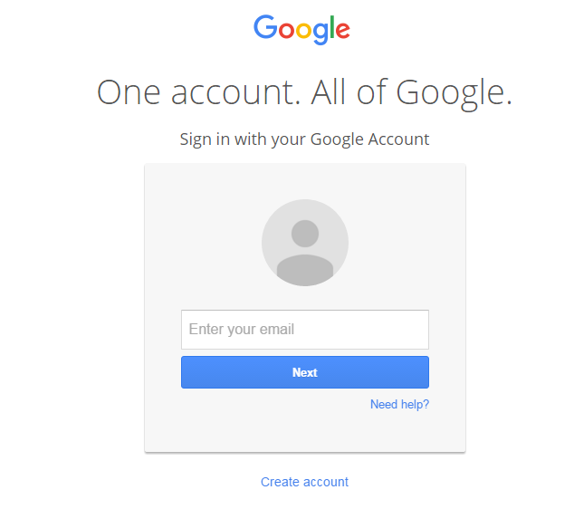
Do you have a google account?
Much of what we are going to do in today’s presentation requires the use of a Google Account. If you have a Google Account, please log in now. If you do not have a Google account, please go to www.google.com. Click “sign in” at the top right hand corner of the page. It will take you to a screen that looks like this:
Click “Create Account” and follow the prompts.

Slide 2
“Getting Your Feet Wet” With Technology in the classroom
PAMLE State Conference
Monday, February 29, 2016

Slide 3
Welcome!
Megan Miller
mmiller@mbgsd.org
6th, 7th, 8th Grade Social Studies
Mechanicsburg Middle School
Michael Petrillo
mpetrillo@mbgsd.org
6th, 7th, 8th Grade Science
Mechanicsburg Middle School

Slide 4
How does using technology enhance student learning?

Slide 5
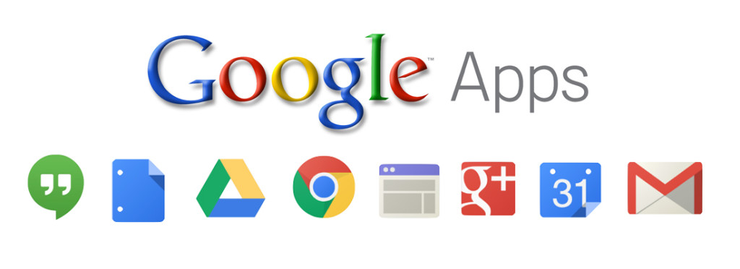
The wonderful world of Google Apps
Google Docs
Google Slides
Google Drawing
Google Forms/Sheets
Google Sites
Google Classroom
Image taken from: http://d3s5n6bbhxr3im.cloudfront.net/wp-content/uploads/2015/11/googleapps.jpg

Slide 6
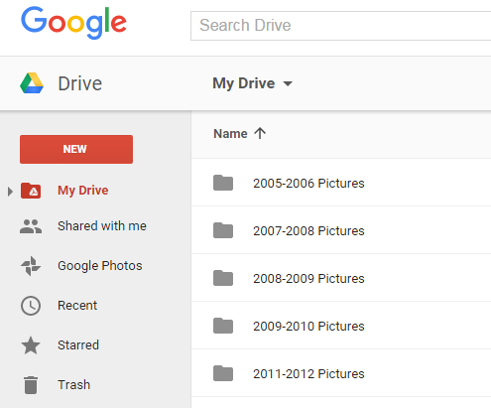
Google Drive: where your files and shared documents are stored
On-line storage; no need for flash drives!
Where you can create and share Google Docs, Slides, Forms, Drawings, etc…
Where you can access shared files created through the Google Apps

Slide 7
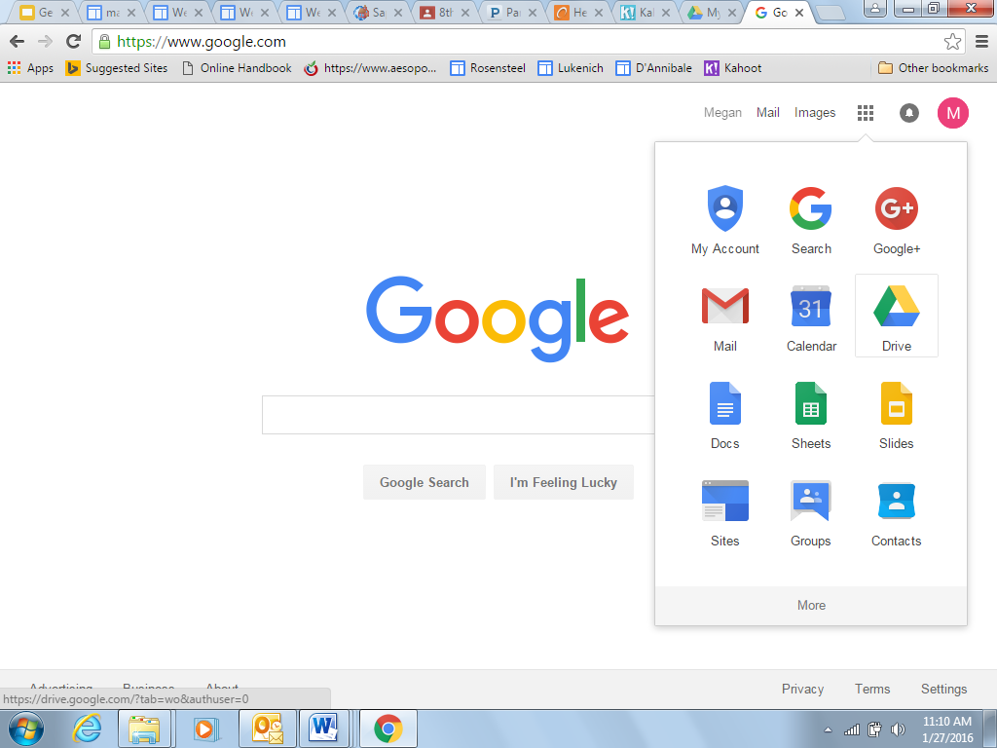
How Do I access my Drive?
Once you’re logged into Google, click on the “checkerboard” icon in the top right hand corner.
A selection of Google Apps will appear.
Click on “Drive”

Slide 8
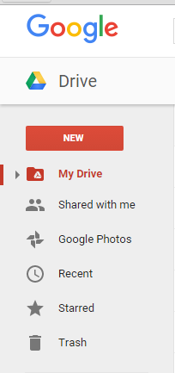
Creating and using google apps within the drive
Once you open your Drive, you can create, share, and view files that have been shared with you

Slide 9
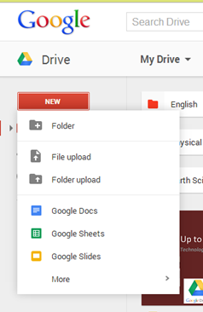
Google Docs
Works like Microsoft Word
Allows multiple students to collaborate in real-time without being in the same place
Great for essays, lab reports, book reports, or anything else that requires word processing
Can upload existing Word files as Google Docs

Slide 10
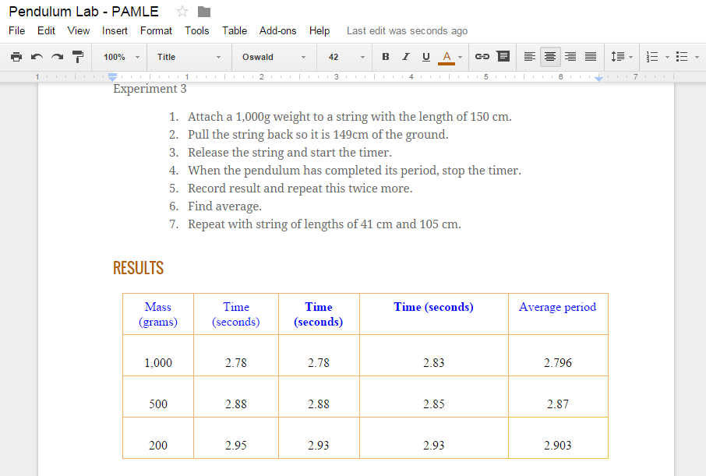
Student Example

Slide 11
Google Slides
Works like Microsoft Power Point
Allows multiple students to collaborate in real-time without being in the same place
Great for presentations
Can upload existing Power Points as Google Slides

Slide 12
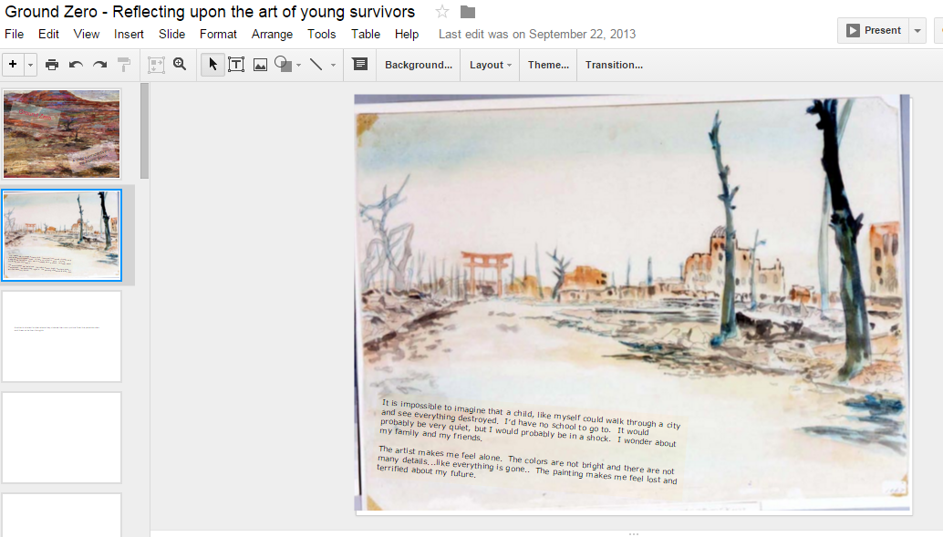
Class example

Slide 13
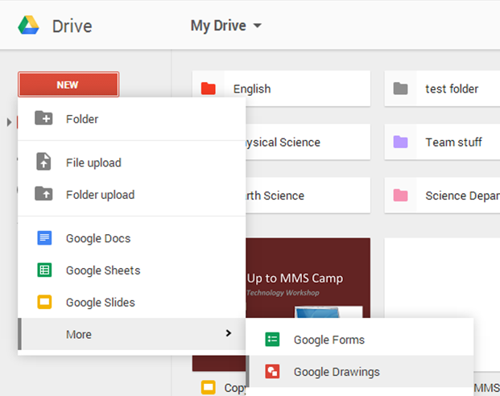
Google Drawing
Allows multiple students to collaborate in real-time without being in the same place
Great for creating graphic organizers and summarizers

Slide 14
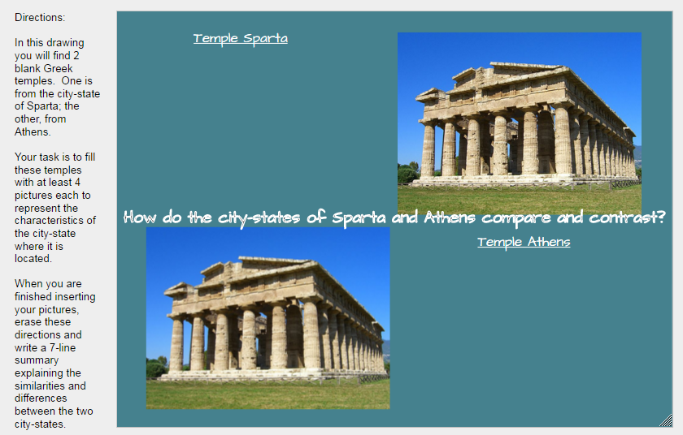
Student Example

Slide 15
Google Classroom
What is Google Classroom?
“Classroom is a free web-based platform that integrates your Google Apps for Education account with all your Google Apps services, including Google Docs, Gmail, and Google Calendar. Classroom saves time and paper, and makes it easy to create classes, distribute assignments, communicate, and stay organized.
Teachers can quickly see who has or hasn't completed the work, and provide direct, real-time feedback and grades right in Classroom.”
“About Classroom.” About Classroom. Google. Web. 27 Jan. 2016. <https://support.google.com/edu/classroom/answer/6020279?hl=en>.

Slide 16
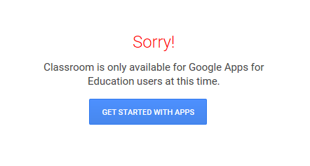
Getting started with Google Classroom
How do you want to organize your classroom? By class periods? Different subjects? Different grades?
You must have a Google Apps for Education account. Contact your district’s technology coordinator about this service.

Slide 17
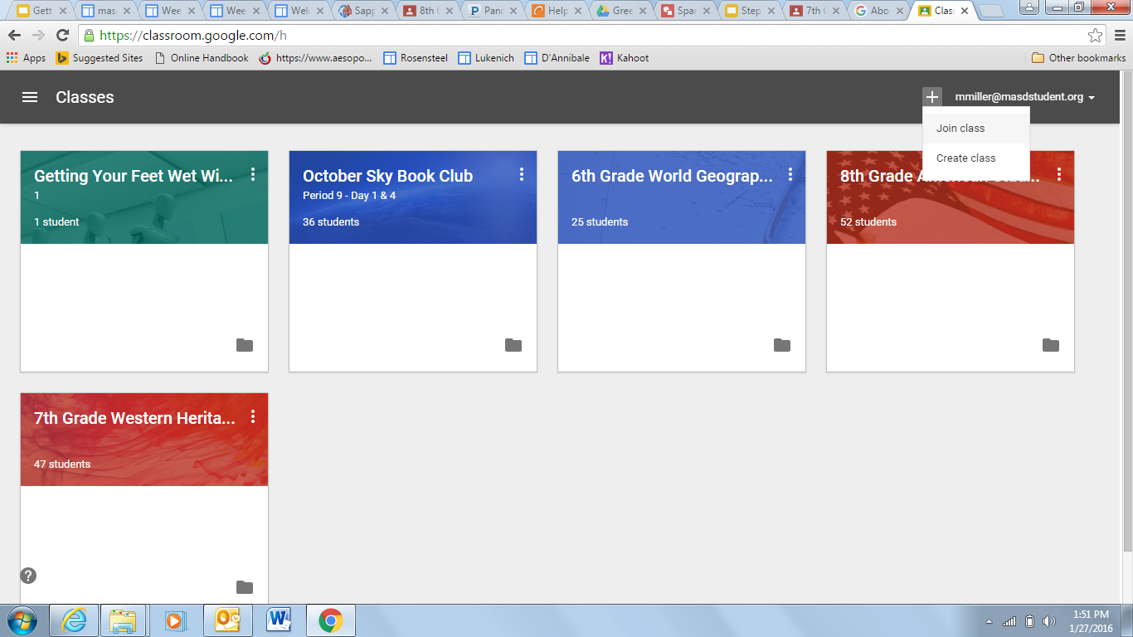
To Set Up a class...
NOTE: Please do not do this right now. We want to show you what the “teacher side” looks like. We are going to have you enroll in our Google Classroom as students.

Slide 18
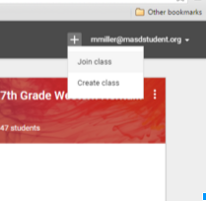
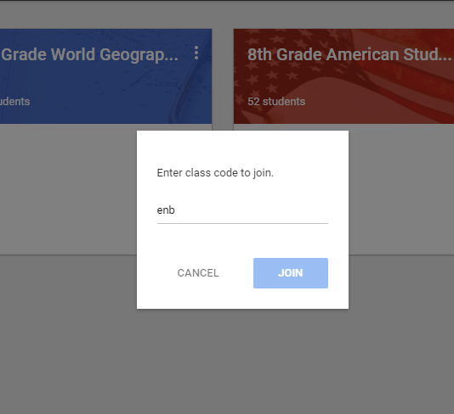
How do students join my class?
Notes:
Delete this slide if the Internet is accessible. Will demonstrate in real time.

Slide 19
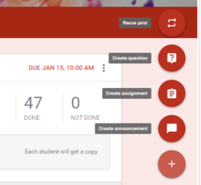
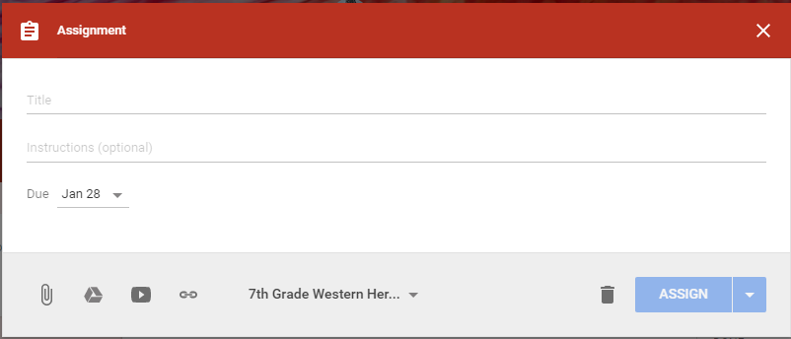
How do I create Assignments?
Second, click “create assignment”
First, click the plus sign.
Finally, enter assignment info, set a due date, and attach files.
Notes:
Delete this slide if the Internet is accessible. Will demonstrate in real time.

Slide 20
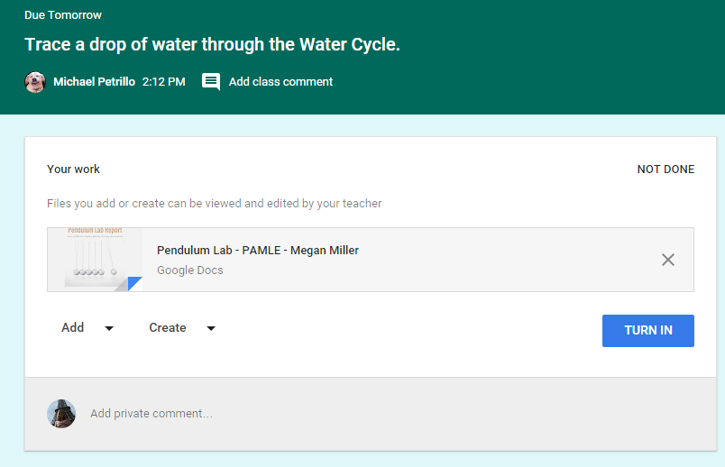
How do students turn in assignments?
Once students are finished working on their Doc, Slide, or Drawing, tell them to close it and go back to their Google Classroom page.
Students should click “Turn In”

Slide 21
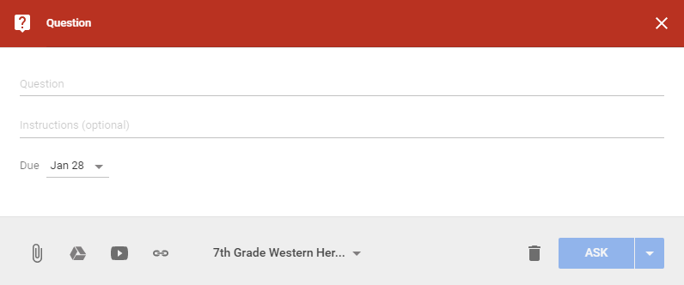
How can i create a discussion question?
Second, click “create assignment”
First, click the plus sign.
Finally, enter question info and due date.

Slide 22
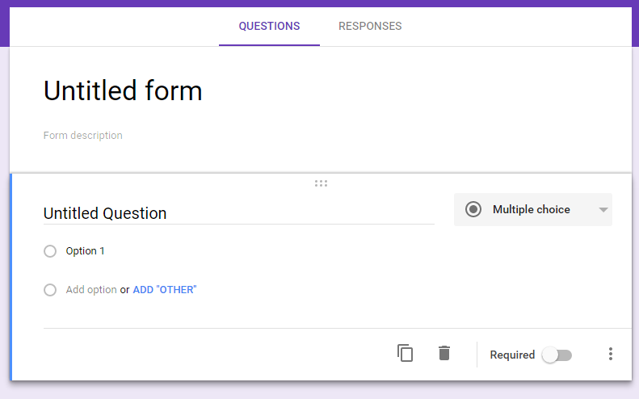
Google Forms
Great for surveys/gathering information
Excellent platform for online tests and quizzes

Slide 23
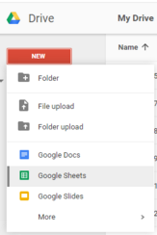
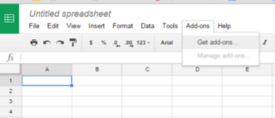
Grading Extension - Flubaroo
Step 1 - Open a new Google Sheet
Step 2 - Click “Add-ons” and “Get add-ons”
Step 3 - Search for “Flubaroo” and add it

Slide 24
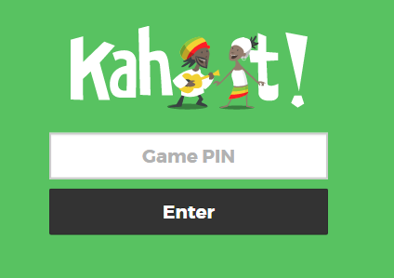
Kahoot!
Great interactive tool
Review for tests, quizzes
Check for comprehension
We are going to review material from today’s workshop using Kahoot!

Slide 25
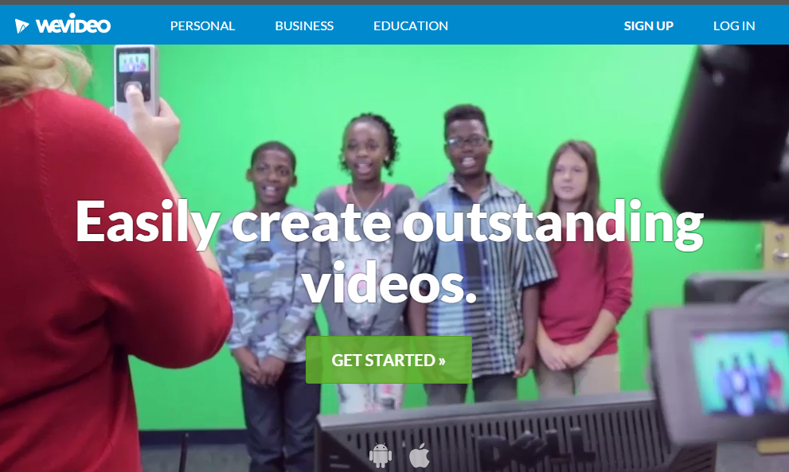
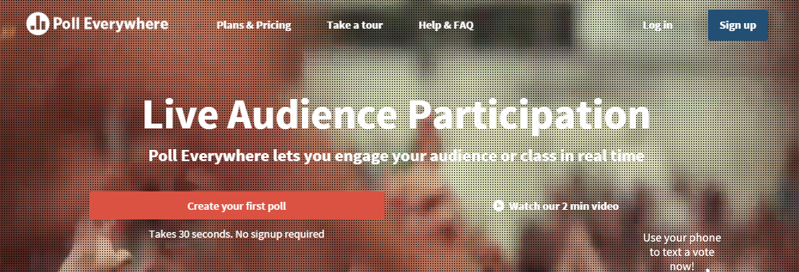
Other Cool resources
We Video
iMovie/Green Screen Technology
Quizlet
Poll Everywhere
Ed Puzzle

Slide 26
We Video
Great for creating documentaries and videos
This is a subscription service - check with your district’s Technology coordinator
Also an excellent tool for “flipping” your classroom - easy to make screen shot videos using your own Power Points
Can download projects straight to your Google Drive

Slide 27
For Mac Users - I Movie
Creates the same types of projects as We Video
Using a Green Screen can allow students to put themselves in front of any background that they choose
Image taken from: http://www.apple.com/mac/imovie/

Slide 28
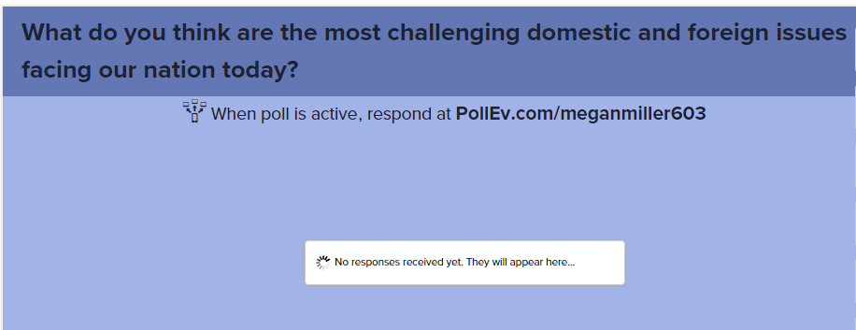
Poll Everywhere
A great tool to generate class discussion
Can be a creative way to activate prior knowledge or have students summarize key ideas

Slide 29
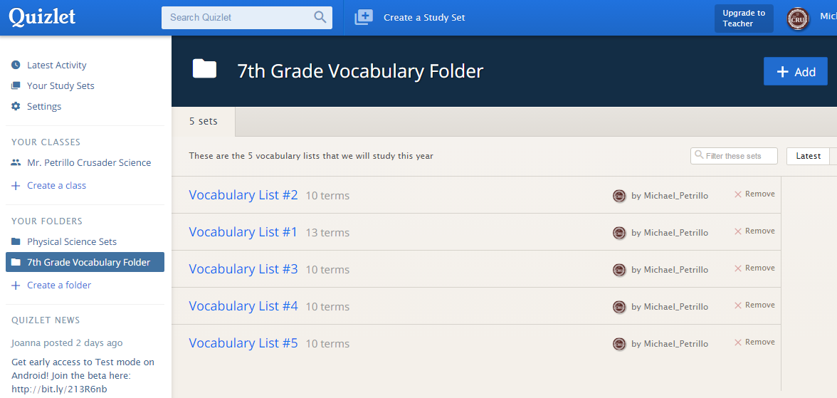
Quizlet
The best way to learn vocabulary and spelling through the use of on-line flashcards.
Creates fun games and keeps track of results for all students who join your group.

Slide 30
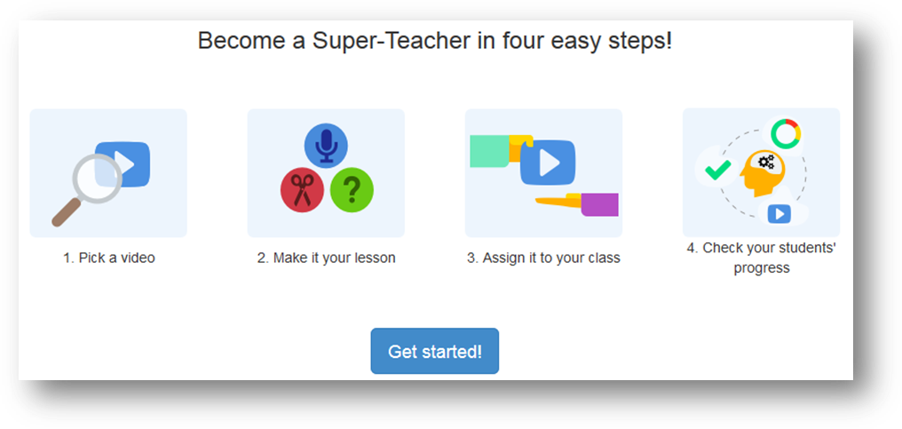
Ed puzzle
Take preexisting videos (Youtube and other sites) and embed questions, comments, and your voice to make it more of an interactive piece.
Easily sent to your Google Classroom classes as an assignment
I created an example, but I need you to look at it. https://edpuzzle.com/assignments/56ca40a1d8ace53c414e37d7/watch
Notes:
I created an example, but I need you to look at it. https://edpuzzle.com/assignments/56ca40a1d8ace53c414e37d7/watch

Slide 31
questions? Please feel free to contact us!
Megan Miller
mmiller@mbgsd.org
6th, 7th, 8th Grade Social Studies
Mechanicsburg Middle School
Michael Petrillo
mpetrillo@mbgsd.org
6th, 7th, 8th Grade Science
Mechanicsburg Middle School

