Slide 1
Best SAP Practices
Hamburg Area Middle School
-Presented by Meredith Hollis & Beth Horrigan

Slide 2
Presentation OVERVIEW
What is the purpose of SAP?
What are the SAP Best Practices?
What does it look like at Hamburg Area Middle School?

Slide 3
What is the Purpose of SAP?
To identify and help those students who have barriers, such as substance abuse, mental health issues, and family stressors, to their learning, and connect them to resources to mitigate the barriers.
Primary goal of SAP = to help the student overcome the barriers so the can achieve and progress.

Slide 4
SAP Team at the Core Alongside School and Community Supports

Slide 5
15 Best Practices of SAP

Slide 6
Best Practice 1-Core Team
1. Develop a core team to include the following:
Building Administrator
A minimum of 4 members representative of all of the groups that comprise school staff, e.g., teacher, counselor, psychologist, nurse, or other related professional staff
Linkages with a community agency, such as behavioral health or drug and alcohol

Slide 7
Best Practice 1 How we apply it at HAMS
We have a supportive Superintendent and Director of Pupil Personnel, neither participate in the weekly meetings; however, they approve team members’ PASAP memberships, SAP maintenance trainings, provide means for weekly affective education groups to be run by a trained professional, and compensate for the team members’ time.
Our building Principal and Dean of Students attend weekly, with the Principal leading the agenda and discussion, keeping discussion focused.
Other members who attend meetings include a teacher from each grade level (6, 7, and 8), 2 enrichment teachers, the school counselor, school nurse, school psychologist, and community agency representative SAP liaison from the Caron Foundation.

Slide 8
Best Practice 2
2. 80 minutes should be allotted per week/cycle for team work.
A common meeting time of 40 minutes per week is suggested.
Part of the 80 minutes should be used for case management and intervention planning.
Meeting time is suggested to be during contract time and not during planning time.

Slide 9
Best Practice 2 How we apply it at HAMS
The entire SAP Team meets every Thursday morning from 7:00 – 7:30 A.M.
Because the teacher contract time starts at 7:30, SAP Team members are permitted to leave 30 minutes early one day that week. Time cannot be carried over!
The HAMS teachers have 2 53-minute prep periods per day, plus lunch and a 40-minute Flex period for academic remediation or study hall which can be utilized for SAP team purposes, such as data collection and case management responsibilities.

Slide 10
Best Practice 3
All team members must attend the entire training provided by a Commonwealth Approved Training Provider. Successful completion of the requirements of the professional training of the SAP Core Team delivered by a Commonwealth Approved Trainer is required.
Participants must attend all sessions at the training to be eligible for SAP certification.
Participants must complete all required assignments in the allotted time to be eligible for SAP certification.

Slide 11
Best Practice 3 How we apply it at HAMS
All of the 12 HAMS Team members are SAP trained and certified, except one of our new teachers is signed up for an up-coming training.
Members: Principal, school psychologist, core teachers and enrichment teachers, and school nurse.

Slide 12
Best Practice 4
The process for accessing SAP services and the steps utilized by the SAP team when a referral is received should be published and distributed to the SAP Team.
Referral forms are located in different areas of the building including the lunch room, lockers, and hallways.

Slide 13
Best Practice 4
A new referral is presented to the SAP Team and discussed.
All referrals are kept in a confidential log. The log is updated weekly by a SAP member.
Based on discussion team decides on how to proceed.
Student Behaviors Appropriate for SAP Referral.
Notes:
3 C’s – break out discussion – how do others care, connect and check up

Slide 14
Observable behaviors

Slide 15
Best Practice 5
The school allocates at least seven hours of in-service/faculty meeting time throughout the first calendar year of program implementation.
During a faculty meeting SAP informs faculty/support staff about the components of the Student Assistance Program and explains the procedures for making referrals to the SAP team.
After the first year, topics related to SAP should become a part of yearly in-services.
All new faculty/staff should receive, through the school’s orientation program, an overview of SAP and an explanation of the procedures for making referrals to the core team.
Information on SAP is made available to all students and parents on a yearly basis.

Slide 16
Best Practice 5 How we apply it at HAMS
The SAP Team presents at faculty meetings informing staff at the beginning of the year the purpose and procedure of the SAP Team.
The SAP Team presents to the students by grade level.

Slide 17
Best Practice 6
The school will orient the school board on SAP prior to training and update them on SAP activities yearly.

Slide 18
Best Practice 6 How we apply it at HAMS
Throughout the school year the SAP Team reports to the school board about presentations, speakers, and statistics for services received.
Guest speakers: Miss Holter- district attorney office, Point of View-
Caron Foundation-Christina Getz

Slide 19
Best Practice 7
The school will develop/revise their drug/alcohol and suicide/behavioral health policies to incorporate SAP.
The CAT trainer will review district policies prior to training of new SAP teams. Both policies should be reviewed by administration at least once every two years and, if necessary, have revisions adopted by the board.
Notes:
What is a CAT Trainer???

Slide 20
Best Practice 7 How we apply it at HAMS
ASK--- CAT???
Groups for students-
Guest speakers -
SAP Success Stories -
Classroom presentations during Health Classes

Slide 21
Best Practice 8
The school will develop guidelines on how parents will become involved in the SAP process.

Slide 22
Best Practice 8 How we apply it at HAMS
The community is invited to attend presentations.
Alert now is used to get the message
HAMS works closely with CARON Foundation.
Notes:
Future plans – parent involvement; dance chaperones; invite parents to celebrate with kids when they are honored

Slide 23
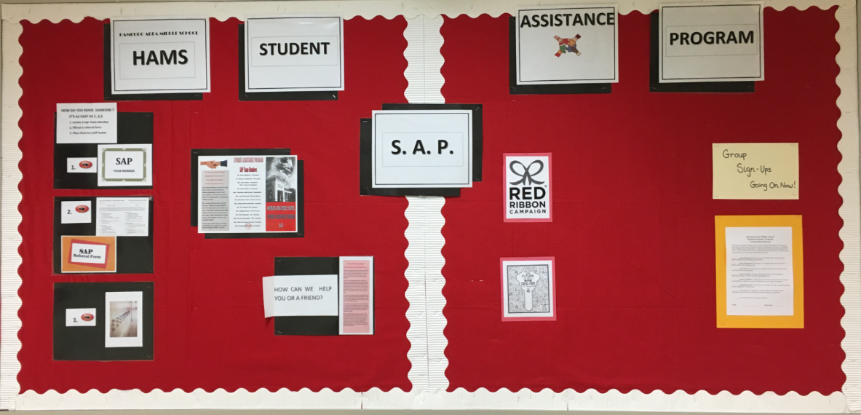
Best Practice 9
The SAP Team will develop ways to work closely with other initiatives in the building to address the needs of students.

Slide 24
Best Practice 9 How we apply it at HAMS
Case managers are assigned to best serve the referred students.
HAMS has an advisory program.
Students are members of teams within a grade.
Notes:
Attendance – how can SAP help; Check and Connect during advisory

Slide 25
Best Practice 10
The SAP Team, working with parents and agencies, is to provide supports for students receiving, or who have received, services from any child-serving agency. The school will establish educational support groups* for students dealing with a variety of issues that interfere with the academic mission of the school within one calendar year of completion of the initial SAP training.
Students in out-patient services or those returning from treatment should receive school-based educational support services.
Group facilitators must attend a group facilitator’s training with an emphasis on child and adolescent issues prior to conducting groups.
Group facilitator training must assist those running groups to separate educational support groups from therapy groups.
All groups conducted in the school should be co-facilitated by at least one school person. A plan for coordinating services with drug/alcohol and behavioral health providers should be developed.

Slide 26
Best Practice 10 How we apply it at HAMS

Slide 27
Best Practice 11
The school will provide time for team maintenance activities at least twice a year.
Drug/alcohol and behavioral health agency liaisons should be included in maintenance activities.

Slide 28
Best Practice 11 How we apply it at HAMS
Team Maintenance is to learn new trends and team building.
Maintenance Days are offered during the summer time.

Slide 29
Best Practice 12
The agency service provider and school will negotiate a written cooperative agreement with the local drug and alcohol and behavioral health agency service system that outlines the following: central referral procedures, consultation/education services, designated liaisons from the drug and alcohol and behavioral health systems, assessment services, emergency crisis assistance, and provisions for treatment, including aftercare. Detailed Letters of Agreement between the schools and the county MH/ID and D&A offices should be written, outlining respective roles, responsibilities, and expectations.
This letter of agreement will be written and signed by agency administrators/directors and school administrators.
The agreement and/or any changes will be negotiated at a minimum of once per year.
A copy of the letter of agreement must be sent to the school’s County Mental Health/Intellectual Disability Administrator and Single County Authority.
A copy of the letter of agreement will be shared with the SAP Team.

Slide 30
Best Practice 12 How we apply it at HAMS
Family Guidance – satellite office in all buildings
Family Guidance offers telepsych services for those individuals who need medications – this is not connected to our roles as educators, but Hamburg supports mental health providers by having the space in our schools
Caron Foundation – weekly psychoeducational groups

Slide 31
Best Practice 13
The school will utilize the conflict resolution process if problems occur between service provider agencies and the school.

Slide 32
Best Practice 13 How we apply it at HAMS
Conflict resolution
Advisory
Assessments
Psycho-Education Groups
Peer mediation or adult led remediation
Health discussions about conflict

Slide 33
Best Practice 14
Each school should submit anonymous on-line referral data through the On-Line Reporting System (PDE 4092) at www.safeschools.state.pa.us and other information as requested by the Commonwealth.

Slide 34
Best Practice 14 How we apply it at HAMS
Confidential google sheet
End of year analysis report is reported to the state.
Notes:
How does everyone else collect data?

Slide 35
Best Practice 15
Agency service providers may provide Educational Support Groups in the school, which are defined as follows: The primary purpose of an educational support group is to provide a safe environment for members of the group to sharpen life-skills, discover new and appropriate behaviors and to increase self-awareness.

Slide 36
Best Practice 15 How we apply it at HAMS
Groups—
Summer Camps—
Health Classes
Psychoeducational Groups
Advisory
Future: Check and Connect
Program – mentor-based program

Slide 37
OTHER THOUGHTS? QUESTIONS?
What do other middle schools do to address MH?
Exploratory?
Advisory?
Clubs?
Transition to/from MS (5th to 6th and 8th to 9th)
Guidance lessons?
Co-teaching and inclusion?

